Slide 1
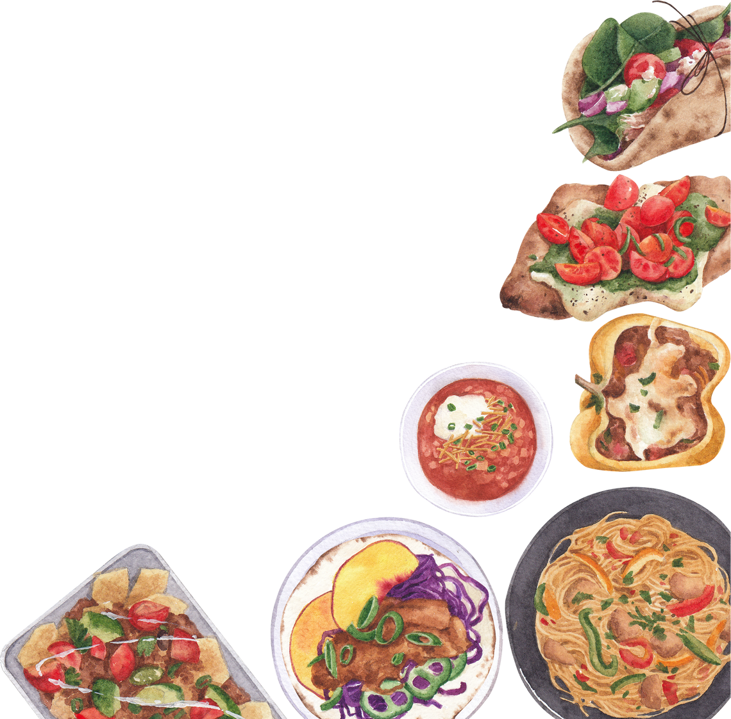
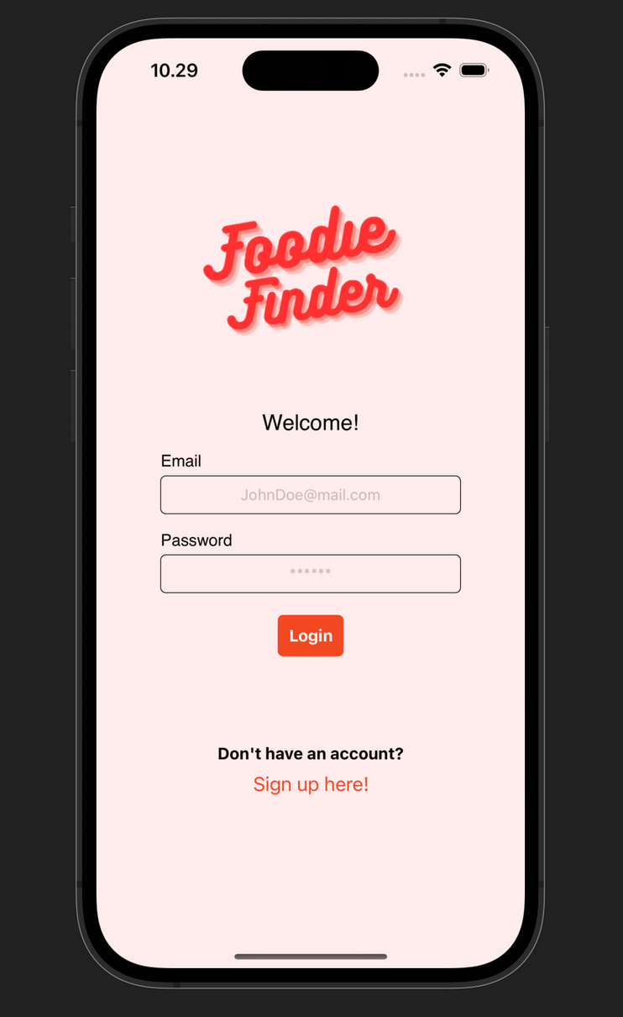


TEAM FOUR - HCK68
proudly present
Foodie
Finder

Slide 2



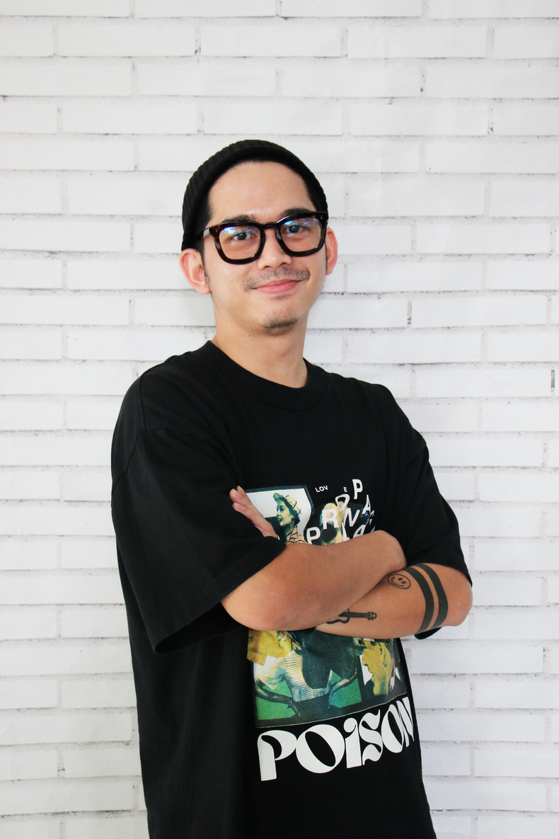
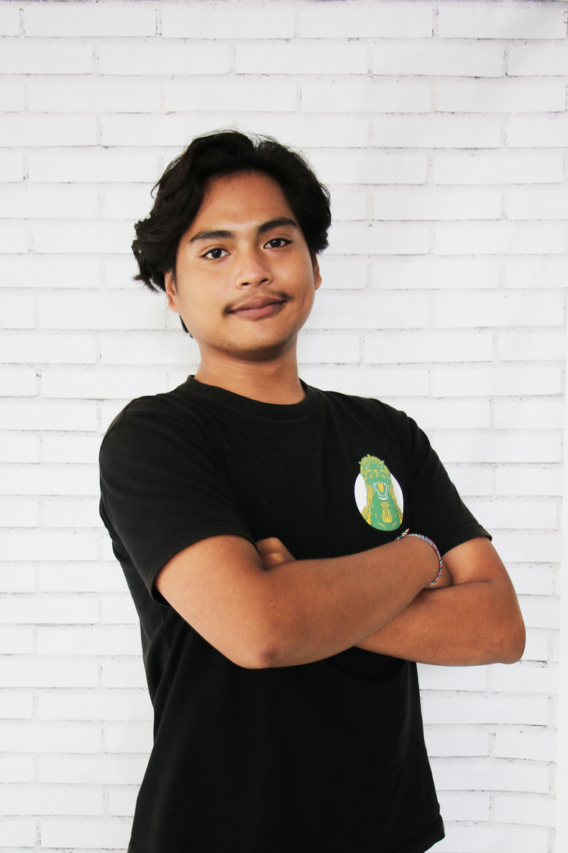

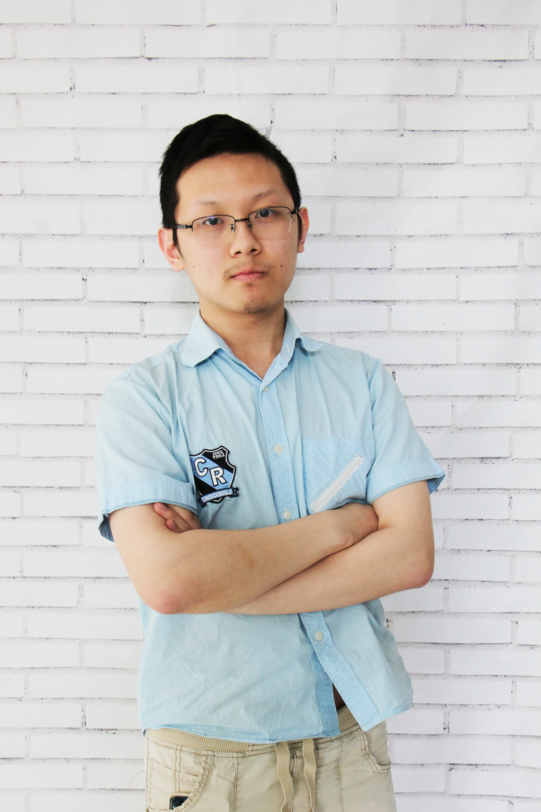
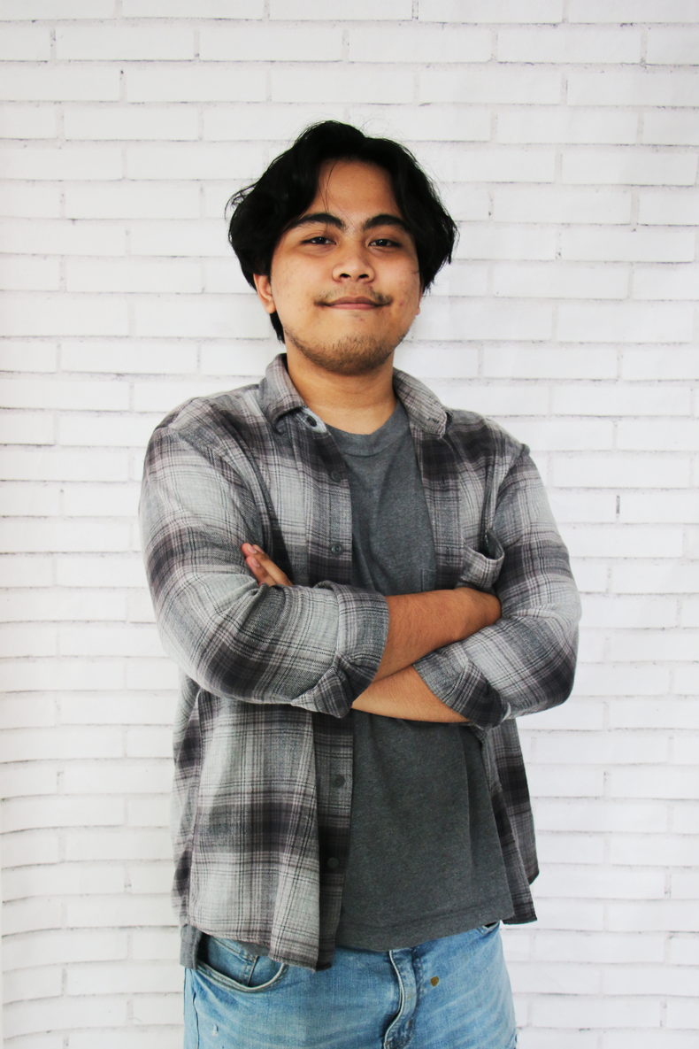
--- Our Team ---
Foodie
Finder
Captain
Full-Stack
Back-End
Naufal Surya
Ronaldo Kwan
Full-Stack
Front-End
M. Ichsan
Rama Dian

Slide 3
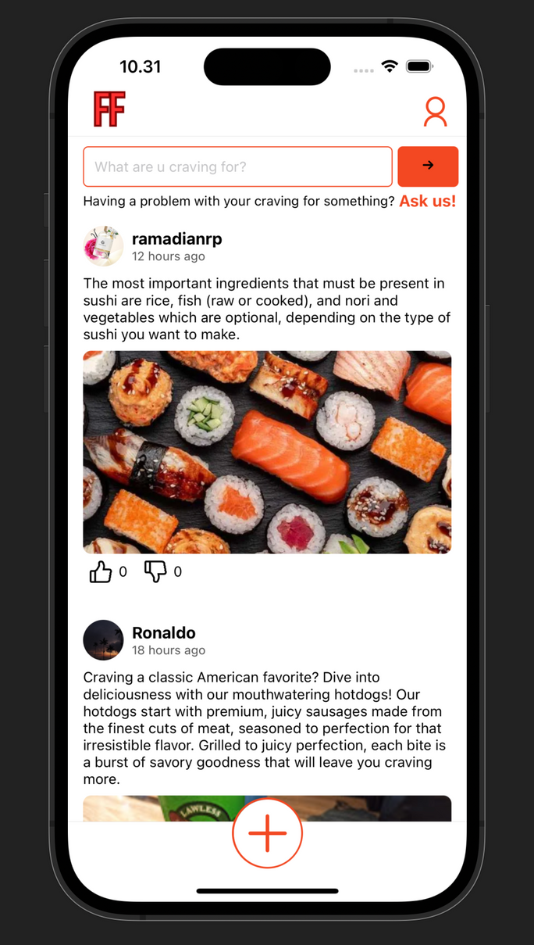

Foodie
Finder
Background
When food enthusiasts gather together
Vision & Mission :
To stimulate food enthusiasts’ desire,
A medium to share their experiences,
Solving about what they are craving for

Slide 4
--- Timeline ---
Foodie
Finder
Activity/Day | 15/04 | 16/04 | 17/04 | 18/04 | 19/04 | 20/04 | 21/04 | 22/04 | 23/04 | 24/04
Brainstorm
Front-End
Back-End
Testing
Wiring
Finalization

Slide 5
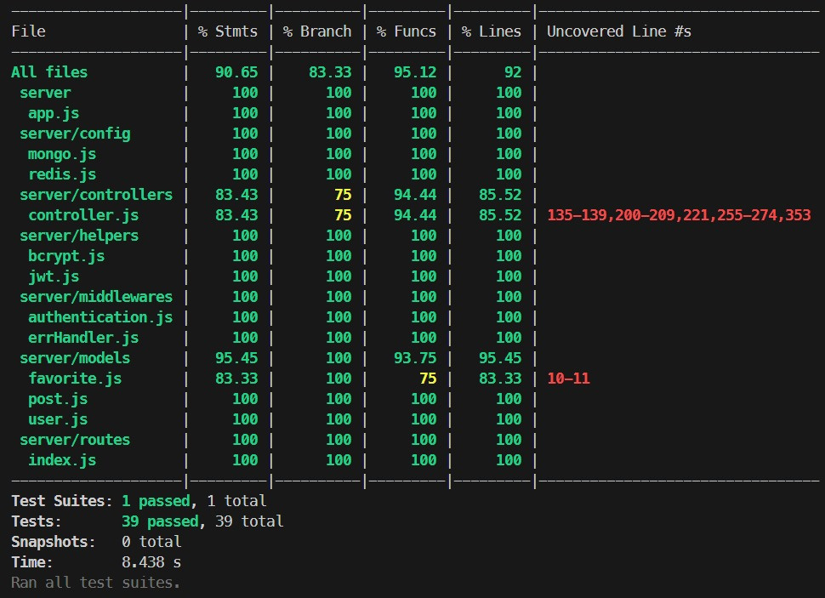
--- Testing ---
Foodie
Finder
Coverage (%)
90,275
Test Cases
39/39

Slide 6
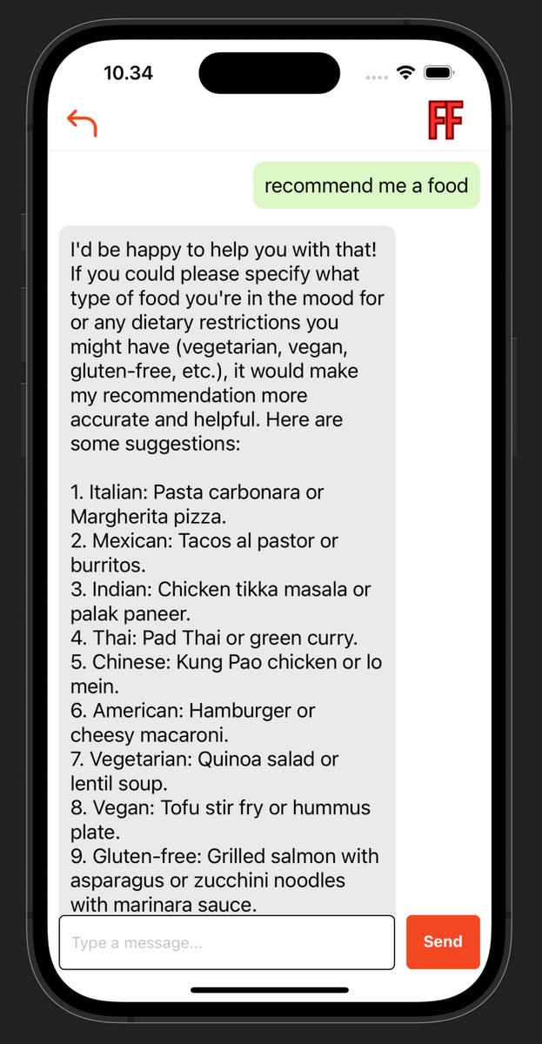
Foodie
Finder
DEMO

Slide 7
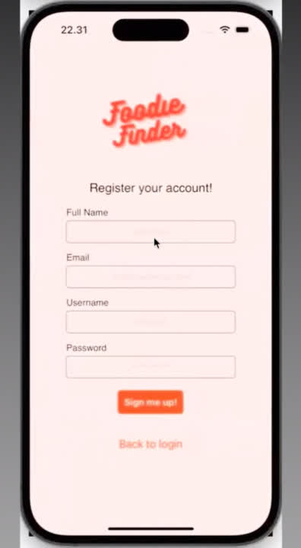
Foodie
Finder

Slide 8












--- Work Flow ---
Foodie
Finder
Front-End
Back-End
Deployment
3rd Party

Slide 9
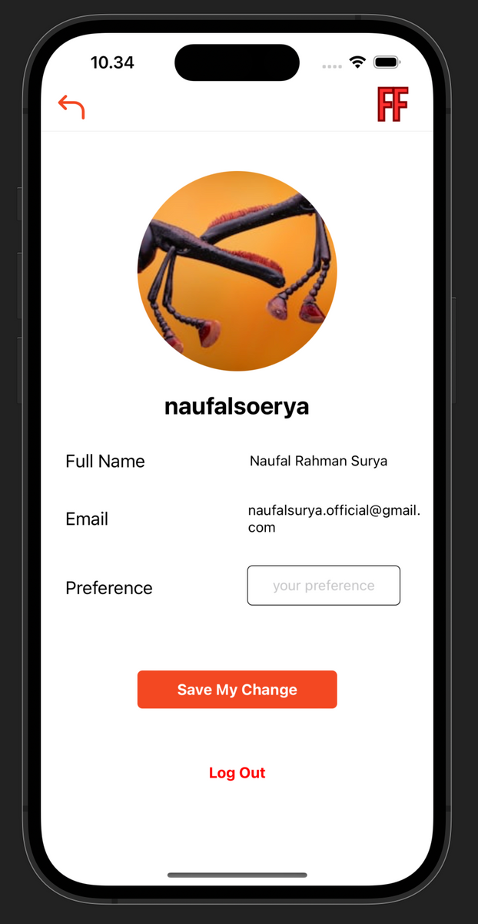
Foodie
Finder
Challenges
Configuring new tech-stack
Layouting
Implementation between technologies
Wiring

Slide 10
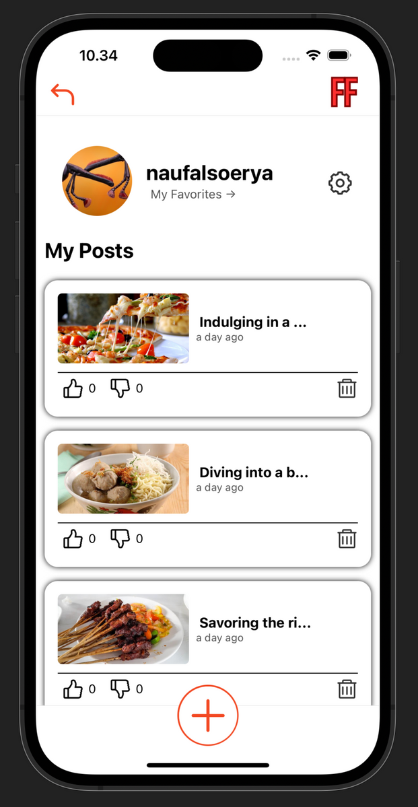
Foodie
Finder
Success Story
Team work
Communication
Commitment
Time management

Slide 11

--- Thank You ---
Foodie
Finder
Captain
Full-Stack
Back-End
Naufal Surya
Ronaldo Kwan
Full-Stack
Front-End
M. Ichsan
Rama Dian

